Slide 1


Beatriz Fernandez
Octubre 2024

Slide 2

Outline
Executive Summary
Introduction
Methodology
Results
Conclusion
Appendix

Slide 3
Executive Summary
Summary of methodologies
- Space X Data Collection using Space X API
- Space X Data Collectión with Web Scraping
- Space X Data Wrangling
- Space X Exploratory Data Analysis using SQL
- Space-X Eda DataViz using Python pandas and Maplotib
- Space-X Lauch Site Analysis with Folium-Interactive Visual Analytics and Ploty Dash
- SapaceX Machine Learning Landing Predicition
Summary of all results
EDA results
Interactive Visual Analytics and Dashbords
Predictive Analysis

Slide 4
Introduction
The commercial space age is here, companies are making space travel affordable for everyone. Virgin Galactic offers suborbital space flights. Rocket Lab is a small satellite provider. Blue Origin manufactures reusable suborbital and orbital rockets.
Perhaps the most successful is SpaceX. SpaceX’s achievements include: sending spacecraft to the International Space Station. Starlink, a satellite internet constellation that provides satellite internet access. Sending manned missions to space. One of the reasons SpaceX can do this is that rocket launches are relatively inexpensive. SpaceX advertises Falcon 9 rocket launches on its website at a cost of $62 million; other providers cost more than $165 million each. Much of the savings is due to SpaceX being able to reuse the first stage. Therefore, if we can determine if the first stage will land, we can determine the cost of a launch. SpaceX’s Falcon 9 launches like regular rockets.

Slide 5

Section 1

Slide 6
Methodology
Executive Summary
Collection methodology:
Using SpaceX's REST API to obtain data on rocket launches.
Using Python's requests library to make GET requests to the API and obtain launch data in JSON format, which is then converted into a DataFrame using the json_normalize function.
Using web scraping with the BeautifulSoup library to obtain HTML table data related to Falcon 9 launches.
Perform data wrangling:
Data manipulation: Flight number, Date, Booster version, Payload mass, Orbit, Launch site, Outcome, Flights, Grid fins, Reused, Legs, Landing pad, Block, Reuse count, Serial, and Launch longitude and latitude.

Slide 7
Methodology
Perform exploratory data analysis (EDA) using visualization and SQL
Creating scatter plots and bar charts with Python to analyze data in a Pandas DataFrame.
Performing exploratory data analysis using Python by manipulating data in a Pandas Data Frame.
Creating and executing SQL queries to select and sort data
Perform interactive visual analytics using Folium and Plotly Dash
Creating a dashboard to analyze launch records interactively with Plotly Dash.
Creating an interactive map to analyze launch site proximity with Folium.
Creating an interactive dashboard with pie charts and scatter plots to analyze data with the Ploty y Dash library in Python.
Visualizing distances on an interactive map by writing Python code with the Folium library.
Creating interactive maps, plotting coordinates, and marking clusters by writing Python code with the Folium library.

Slide 8
Methodology
Perform predictive analysis using classification models
Using Machine Learning to determine if the Falcon 9 first stage will land successfully.
Splitting the data into training and testing data to find the best hyperparameter for SVM, classification trees, and logistic regression. Finding the method that works best using the test data.
Splitting the data into training and test data.
Training different classification models.
Hyperparameter tuning.
Creating a predictive model that helps improve operational efficiency

Slide 9
Data Collection
You should see the response contains massive information about SpaceX launches. Next, let's try to discover some more relevant information for this project.
Request and parse the SpaceX launch data using the GET request
requested JSON results more consistent, we will use the following static response object for this project

Slide 10
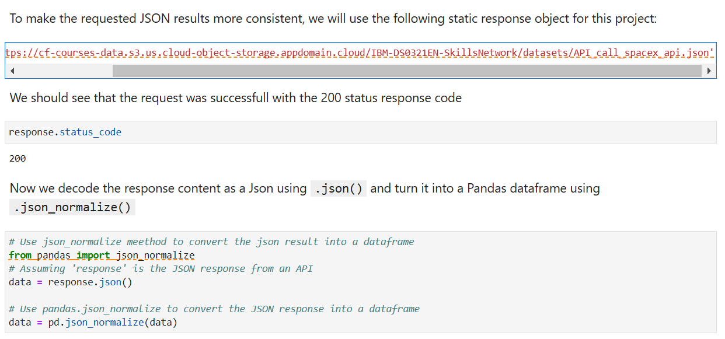
Data Collection – SpaceX API
Present your data collection with SpaceX REST calls using key phrases and flowcharts
https://github.com/Beatrizfv/Spacex-Data-Collection.git
Place your flowchart of SpaceX API calls here

Slide 11
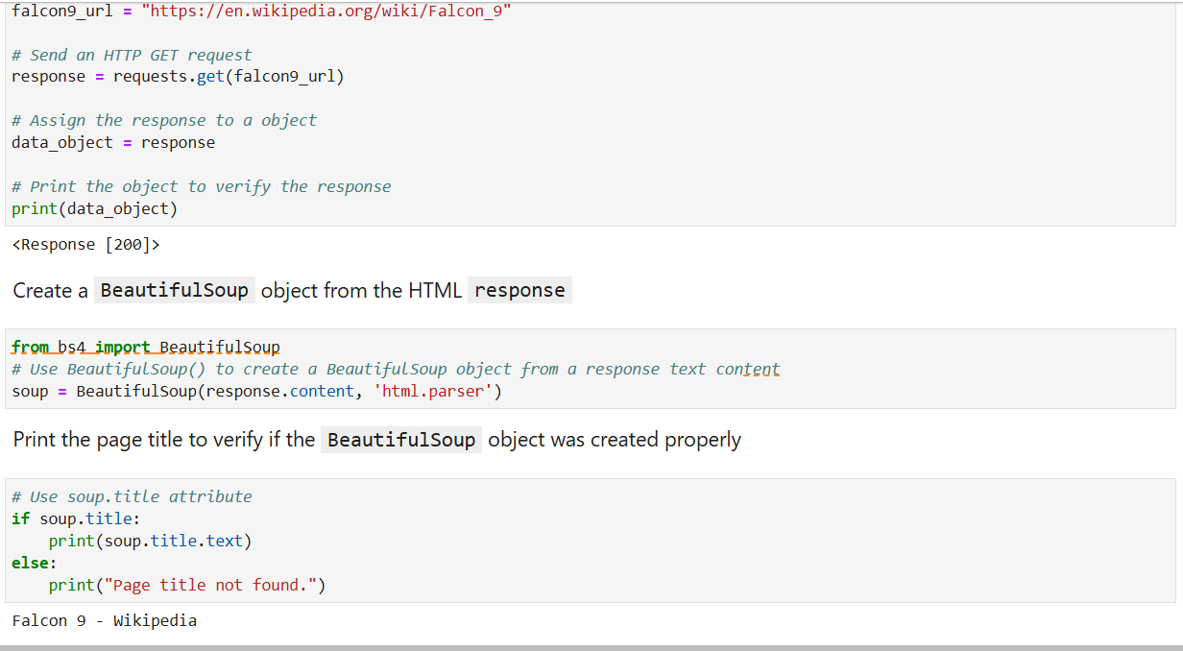
Data Collection - Scraping
Extract a Falcon 9 launch records HTML table from Wikipedia
Parse the table and convert it into a Pandas data frame
https://github.com/Beatrizfv/Spacex-Data-Collection.git
Place your flowchart of web scraping here

Slide 12
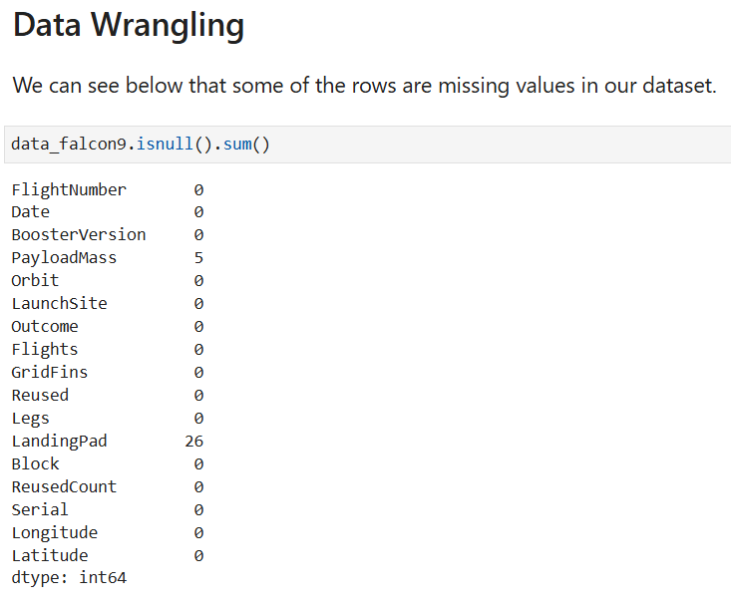
Data Wrangling
You need to present your data wrangling process using key phrases and flowcharts
Add the GitHub URL of your completed data wrangling related notebooks, as an external reference and peer-review purpose
https://github.com/Beatrizfv/Spacex-Data-Collection.git

Slide 13
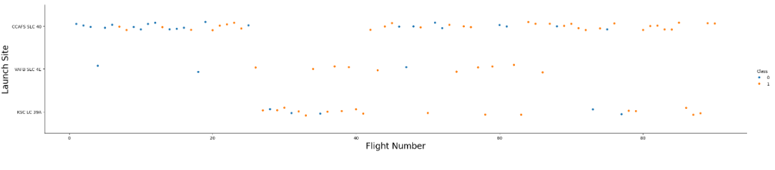
EDA with Data Visualization
Visualize the relationship between Flight Number and Launch Site

Slide 14
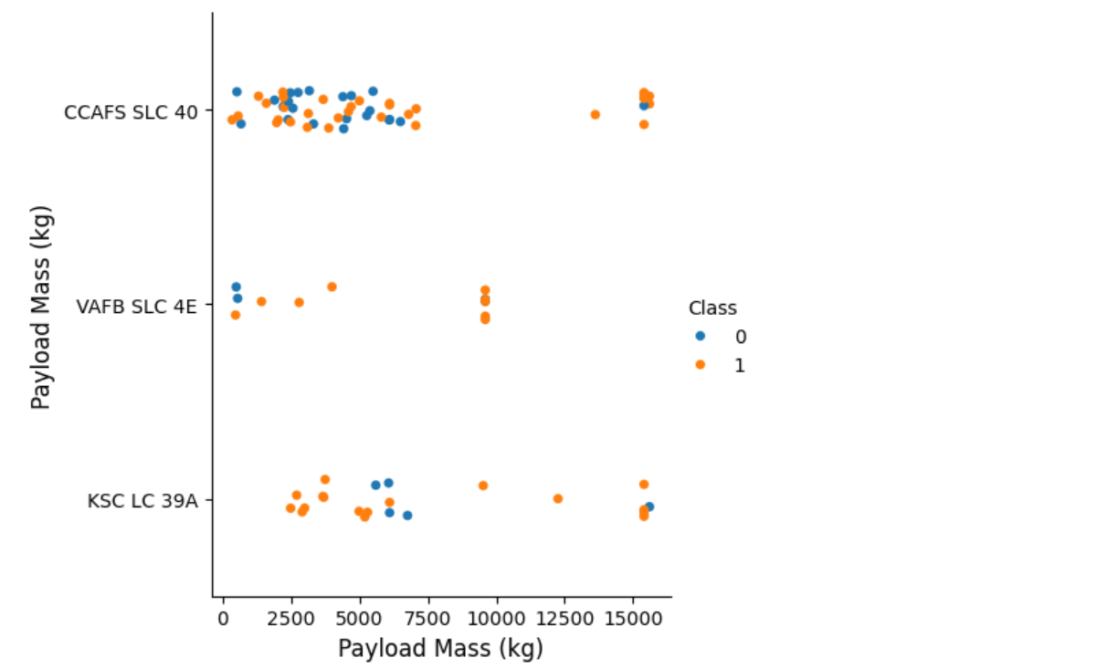
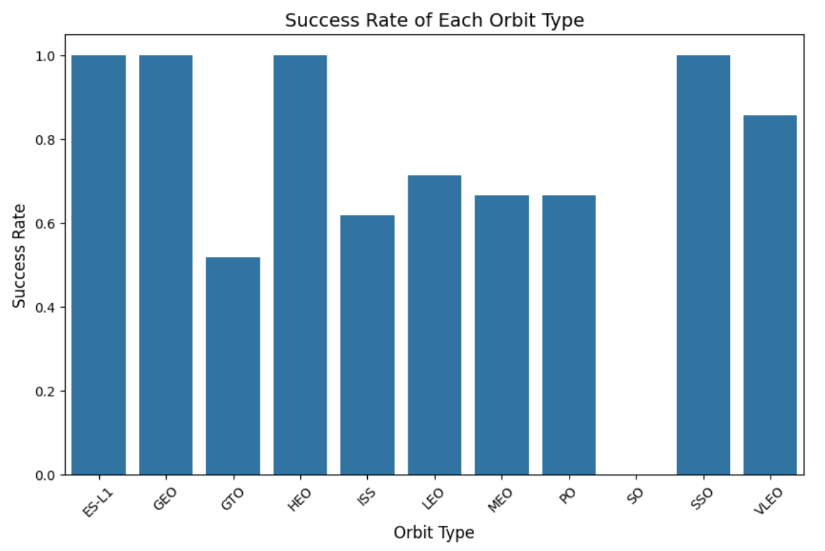
EDA with Data Visualization
Visualize the relationship between Payload Mass and Launch Site Visualize the relationship between success rate of each orbit
type

Slide 15
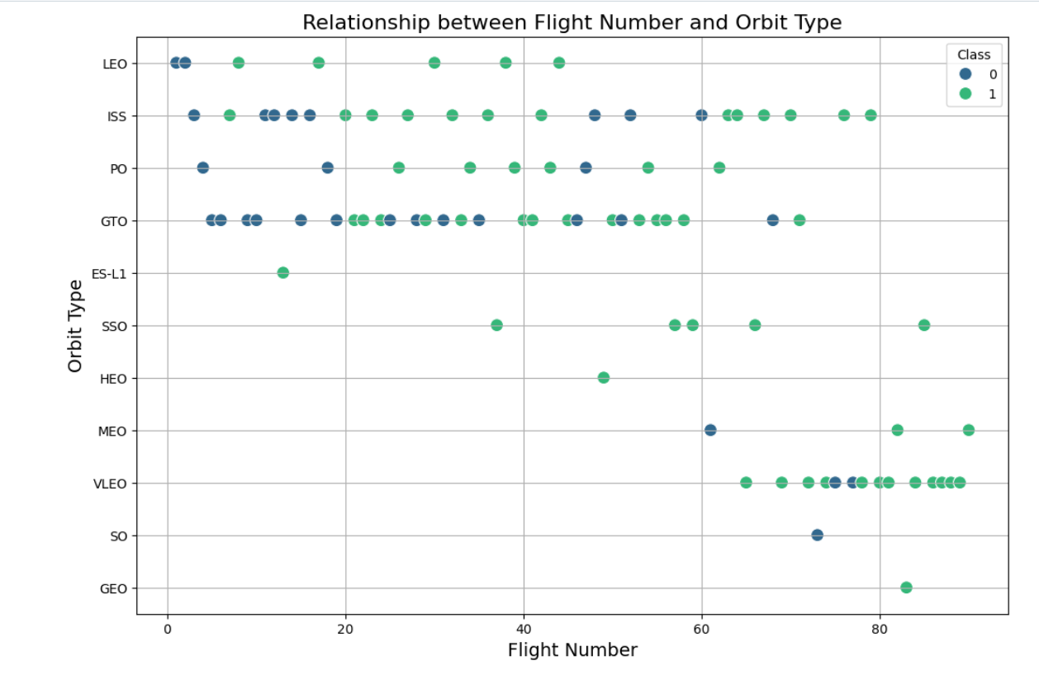
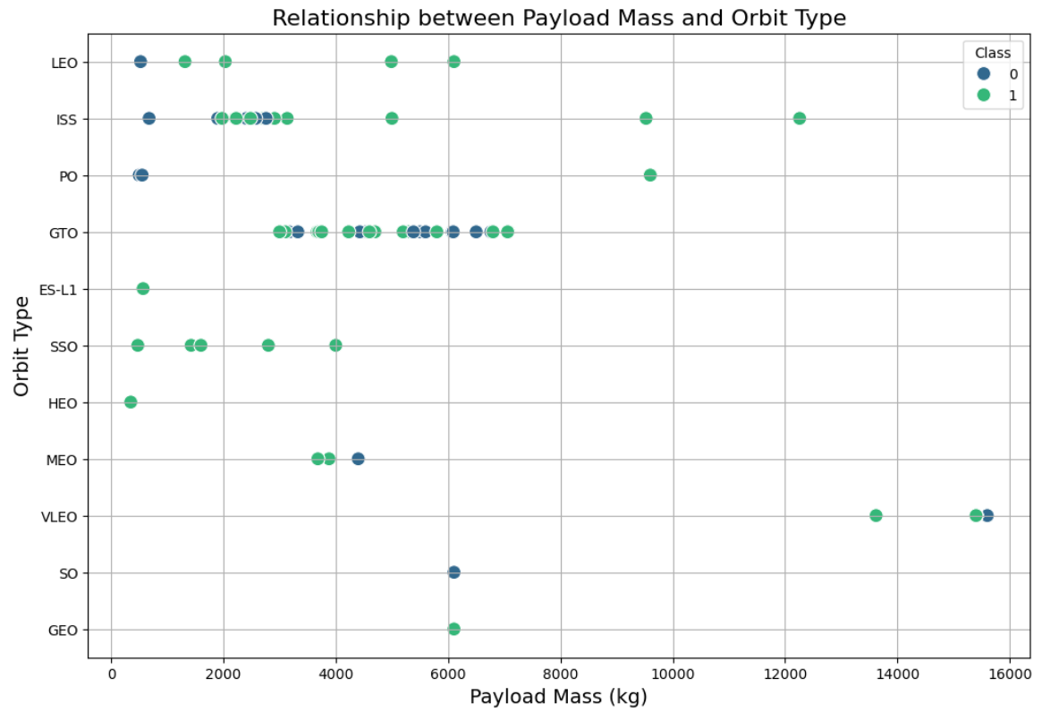
EDA with Data Visualization

Slide 16
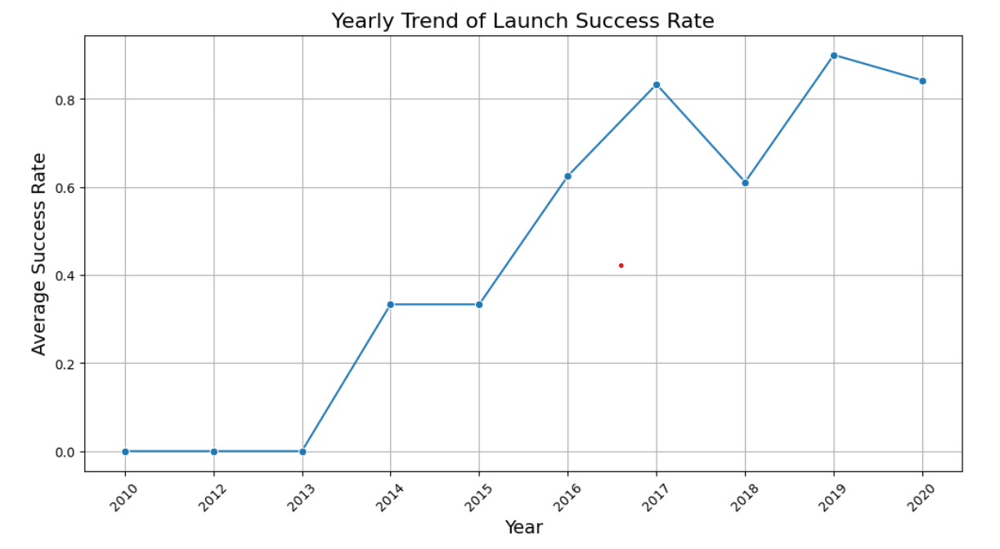
EDA with Data Visualization
https://github.com/Beatrizfv/Spacex-Data-Collection.git

Slide 17
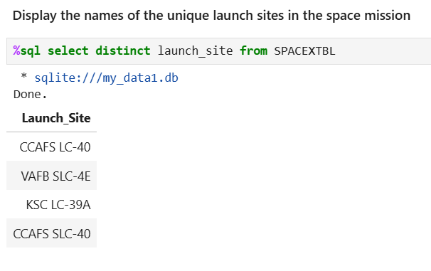
EDA with SQL
SpaceX has gained worldwide attention for a series of historic milestones. It is the only private company ever to return a spacecraft from low-earth orbit, which it first accomplished in December 2010. SpaceX advertises Falcon 9 rocket launches on its website with a cost of 62 million dollars wheras other providers cost upward of 165 million dollars each, much of the savings is because Space X can reuse the first stage.
Therefore if we can determine if the first stage will land, we can determine the cost of a launch.
This information can be used if an alternate company wants to bid against SpaceX for a rocket launch.
This dataset includes a record for each payload carried during a SpaceX mission into outer space.
https://github.com/Beatrizfv/Spacex-Data-Collection.git

Slide 18
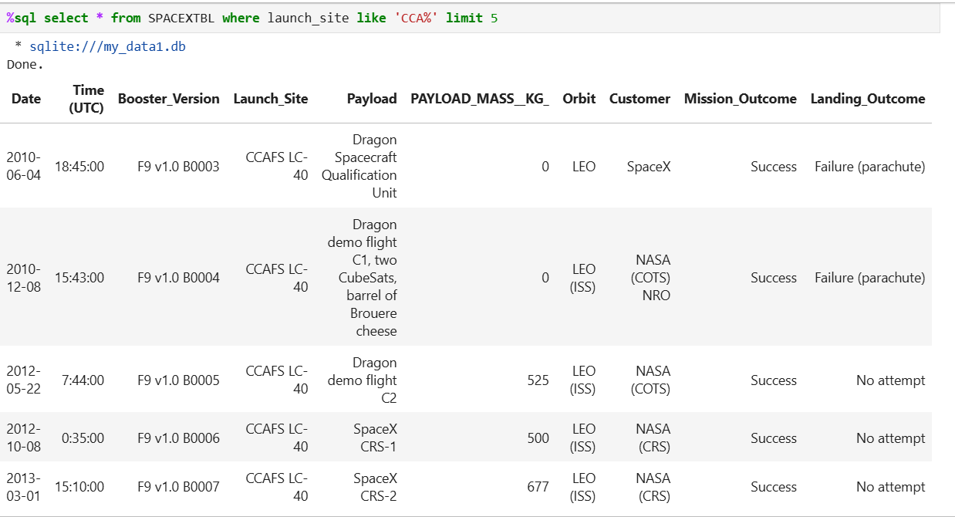
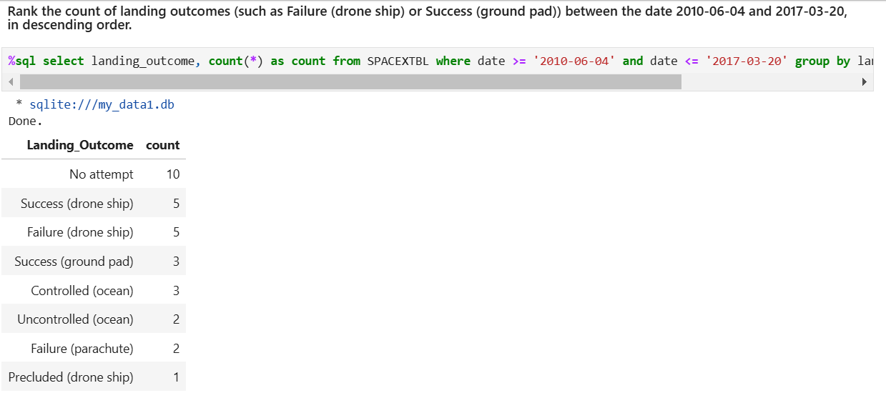
EDA with SQL

Slide 19
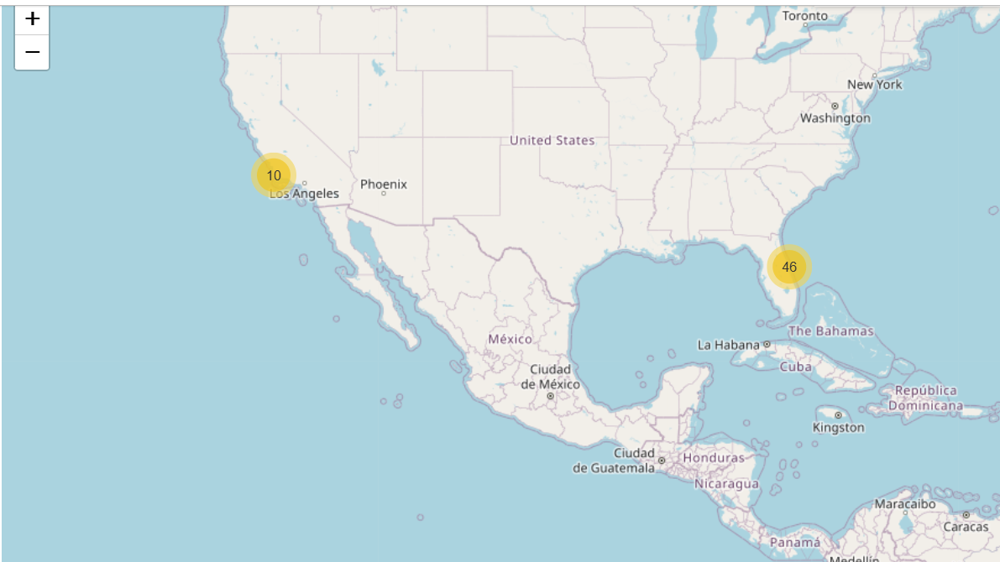
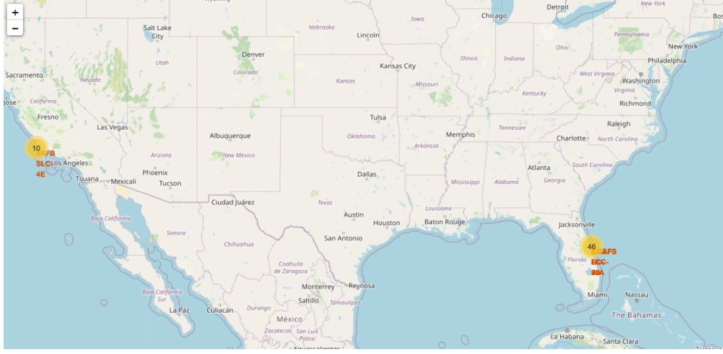
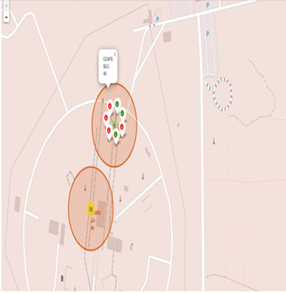
Build an Interactive Map with Folium

Slide 20
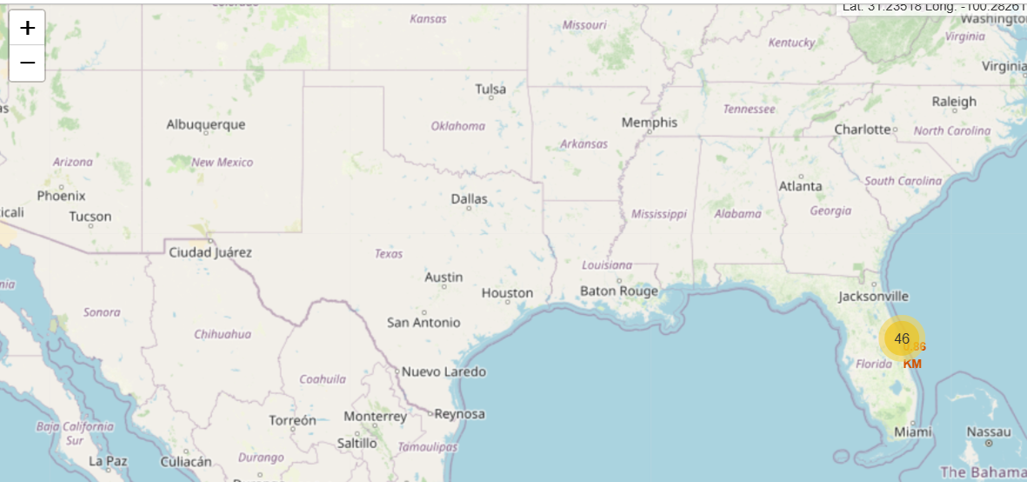

Build an Interactive Map with Folium
https://github.com/Beatrizfv/Spacex-Data-Collection.git

Slide 21
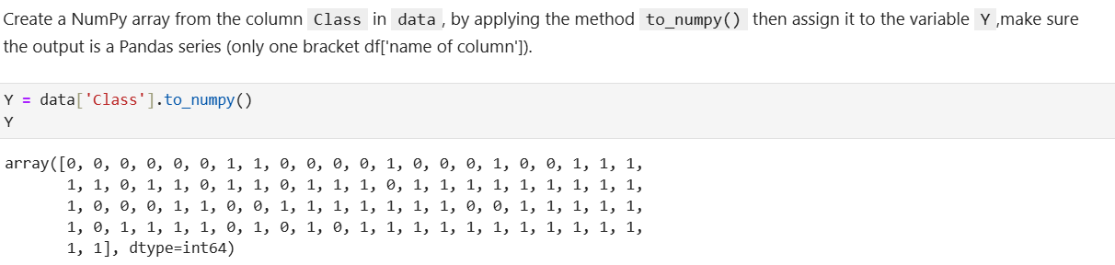
Machine Learning Prediction

Slide 22
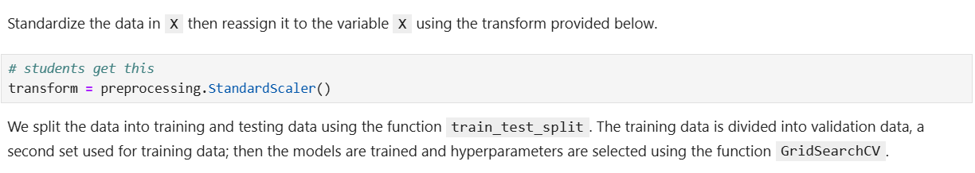
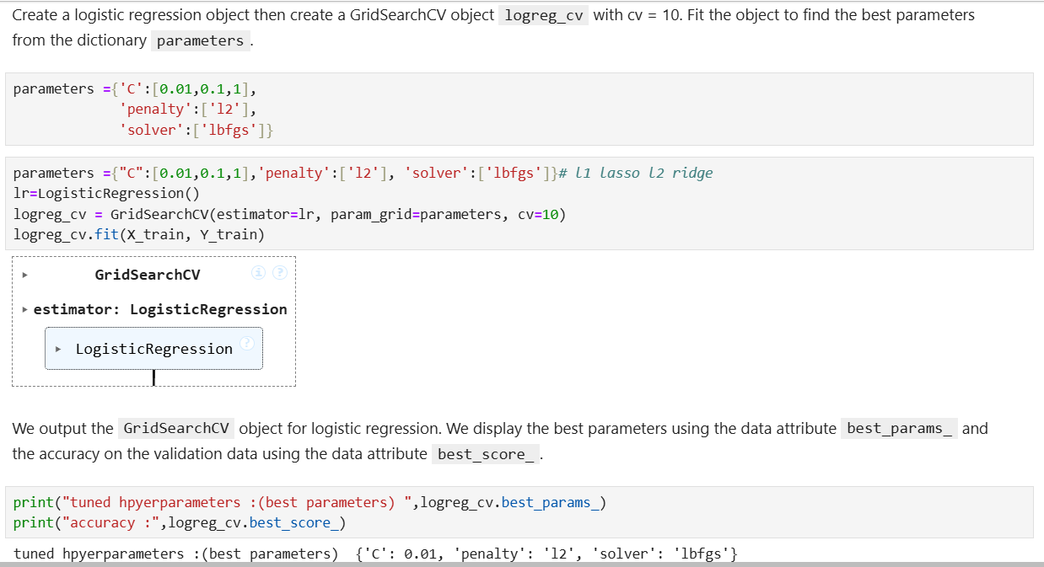
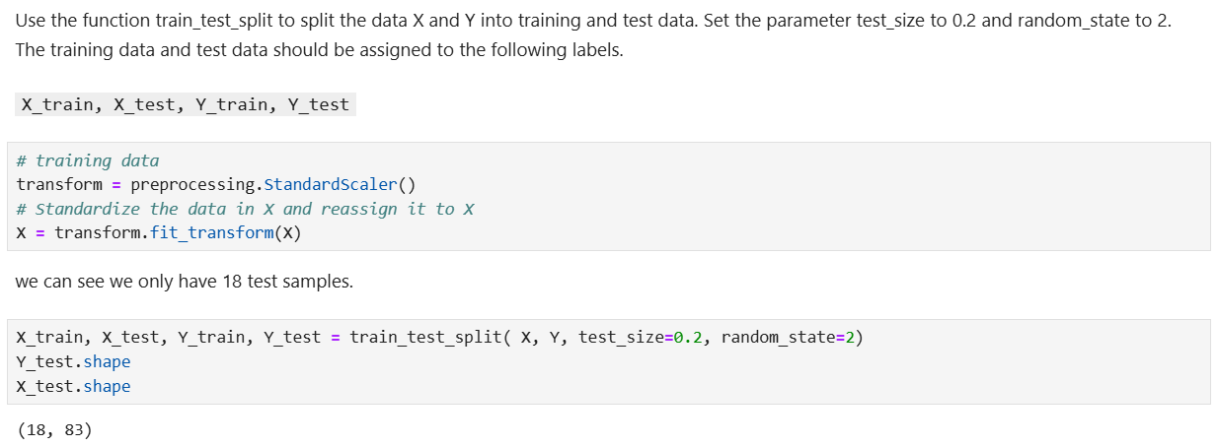
Machine Learning Prediction

Slide 23
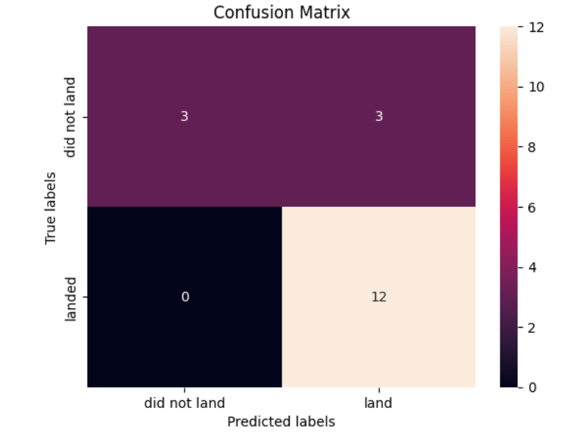
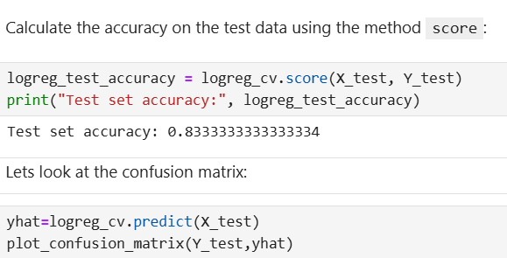
Machine Learning Prediction

Slide 24
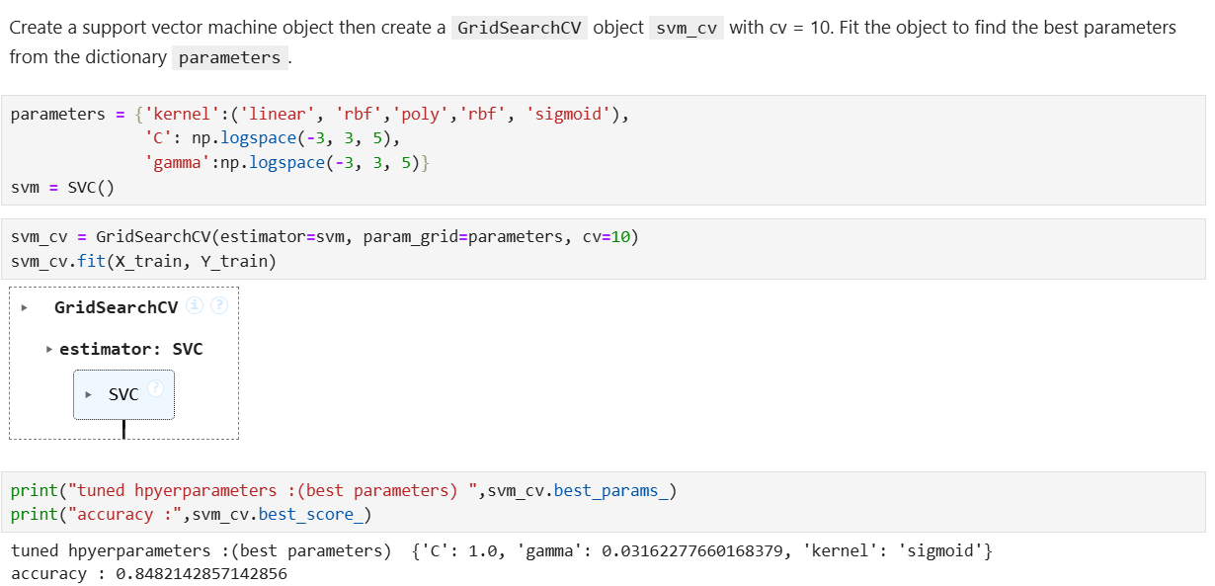
Machine Learning Prediction

Slide 25
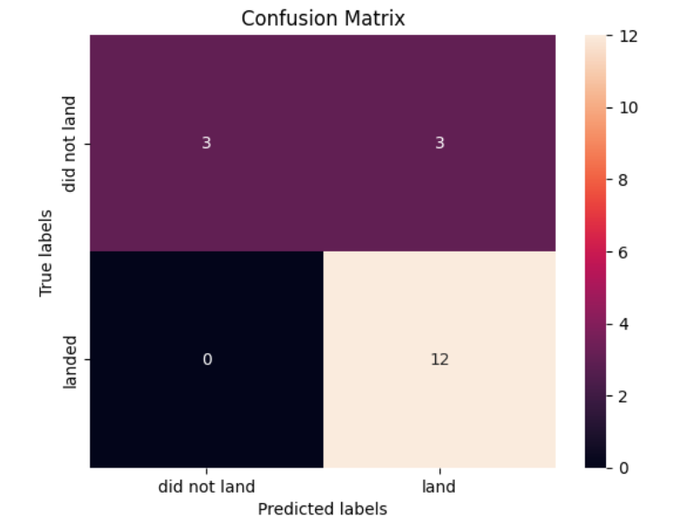
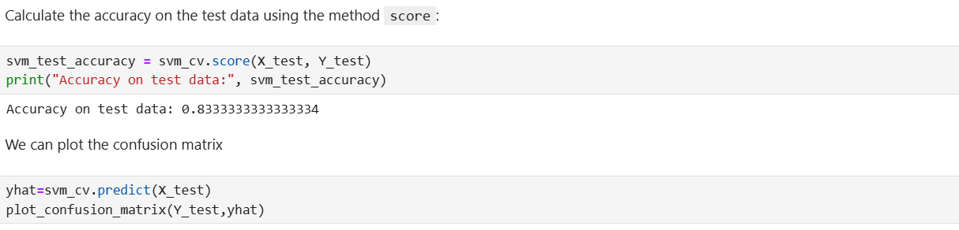
Machine Learning Prediction

Slide 26
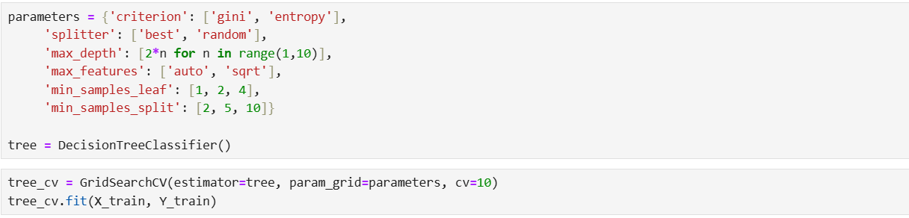
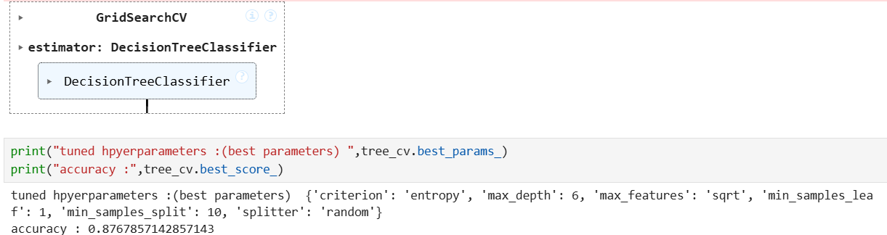
Machine Learning Prediction

Slide 27
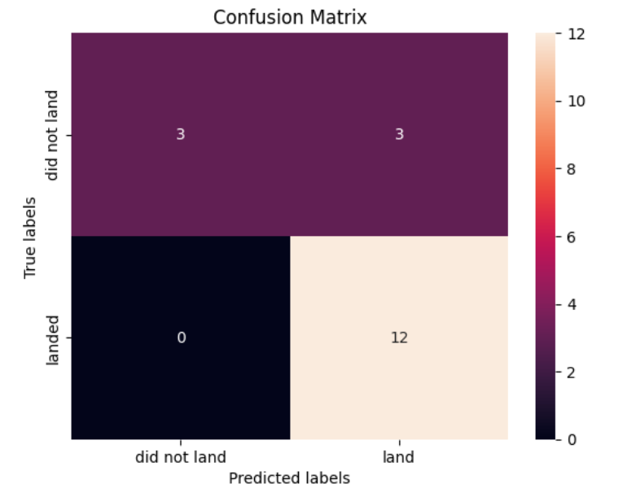
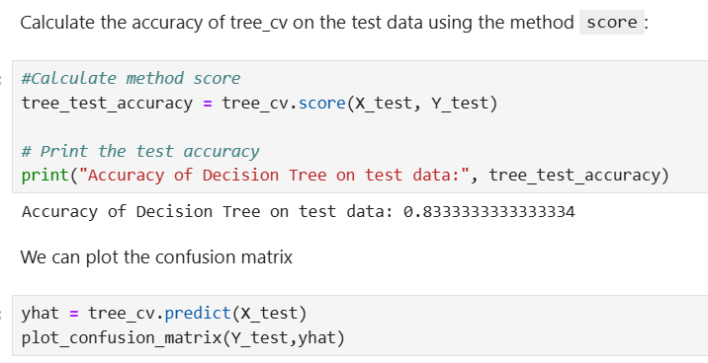
Machine Learning Prediction

Slide 28
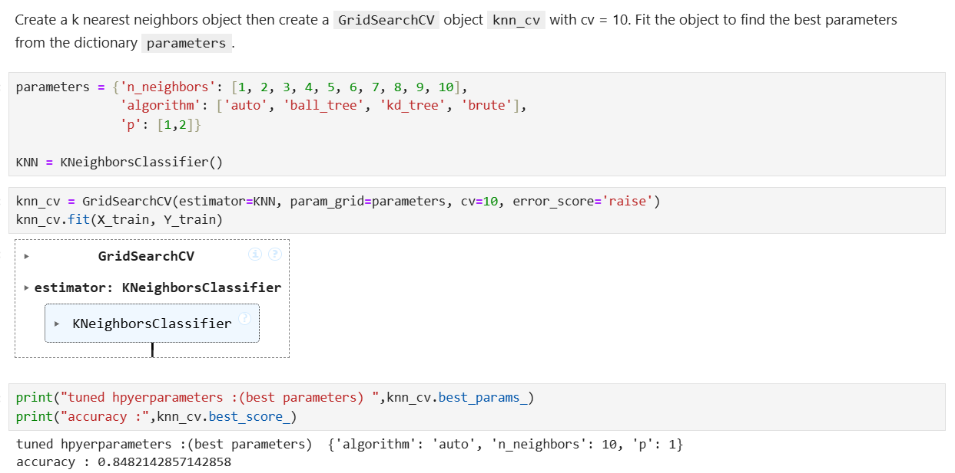
Machine Learning Prediction

Slide 29
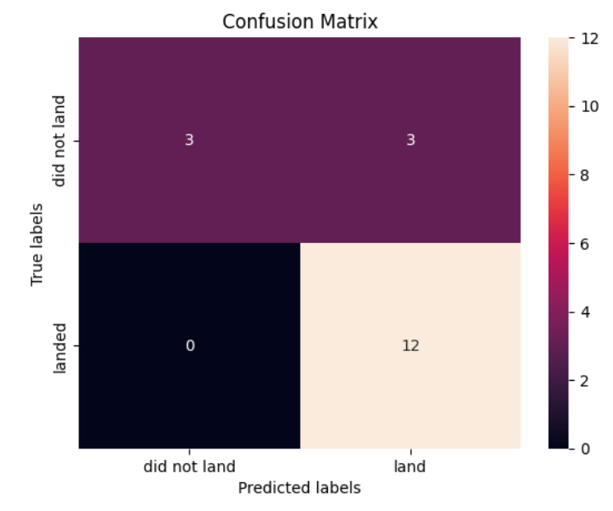
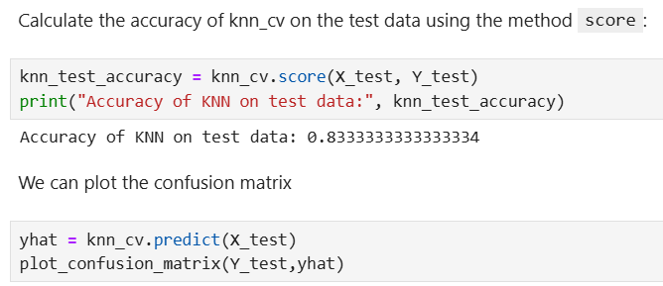
Machine Learning Prediction

Slide 30
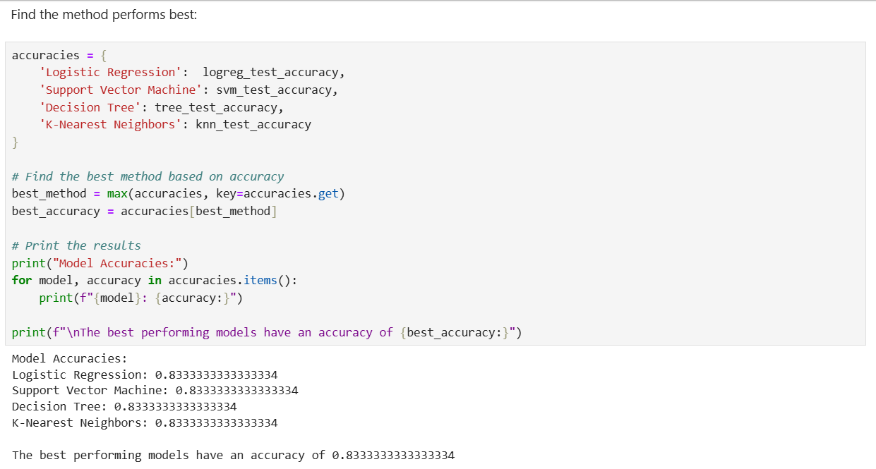
Machine Learning Prediction

Slide 31
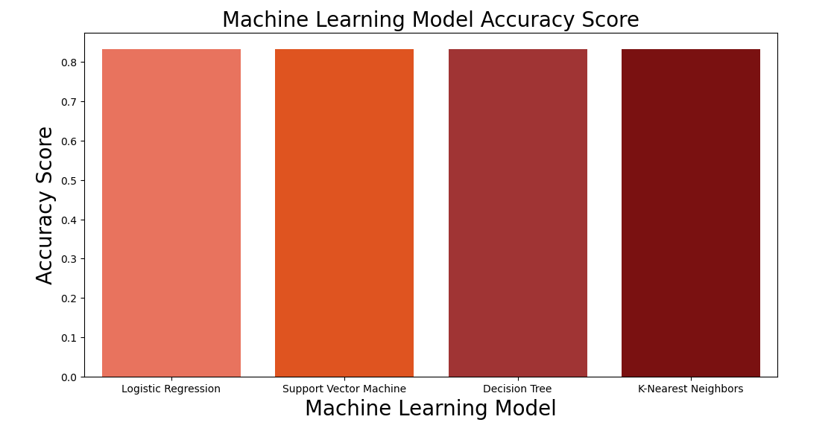
Machine Learning Prediction

Slide 32
Conclusions
Machine learning models can predict the outcomes of SpaceX's Falcon 9 first stage landings with greater accuracy as more launch data is collected. With each new launch, these models become more effective, contributing to the continuous improvement of landing operations

Slide 33


